Slide 1

Spam or No Spam
ETC3250 - Email Classification

Slide 2
Introduction
Data Cleaning
Model 1: Logit Model
Model 2: Logit Model with Interactions
Final Model: Random Forest
Interesting Fact
Potential Improvements
Conclusion

Slide 3
Data Cleaning
replySameAddress (string to dummy variable)

Slide 4
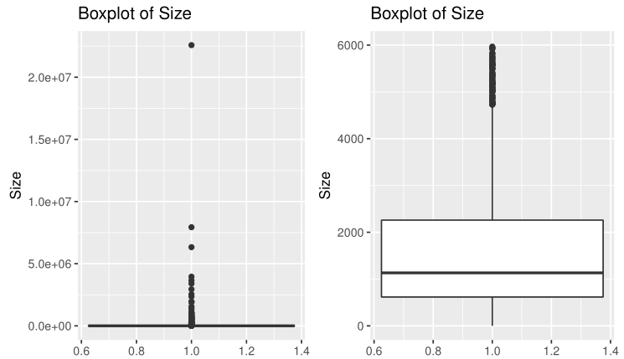
Data Cleaning
replySameAddress (string to dummy variable)
Size (grouping of “big” and “small” emails)

Slide 5
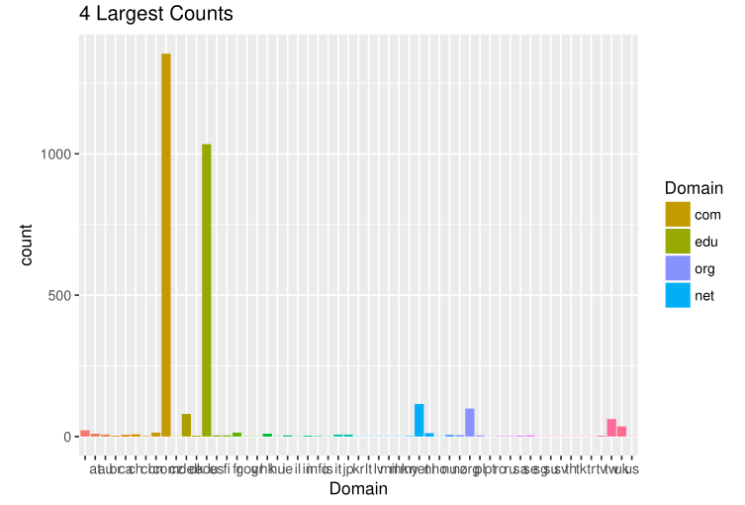
Data Cleaning
replySameAddress (string to dummy variable)
Size (grouping of “big” and “small” emails)
Domain (grouped com, edu and org, and made into a dummy variable)

Slide 6
Model 1 & 2: Logistic Regression (Logit)
Variable Settings | Training Accuracy
Logit with all variables | ~83%
Logit removing insignificant variables | ~79%
Model 2: Logit with interactions | ~88%

Slide 7
Final Model: Random Forest
Model | Mean Squared Errors
Random Forest with Interactions | 0.0956
Random Forest without Interactions | 0.0966
Logit Model with Interaction | 37.6483
Random Forest Training Accuracy = 96.26%

Slide 8
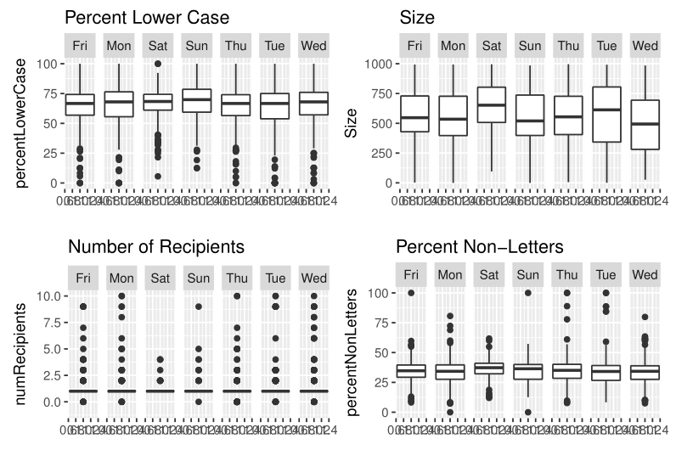
Interesting Fact
Properties faceted by Weekday

Slide 9
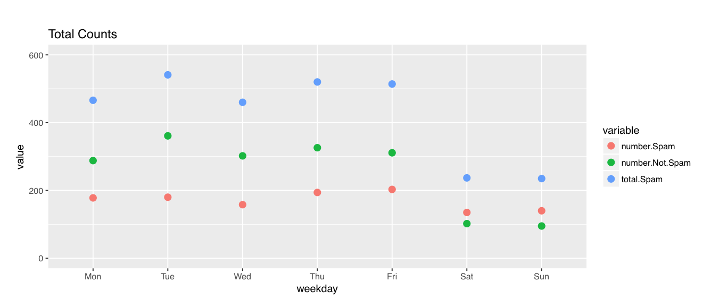
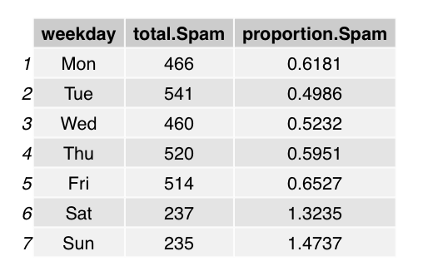
Interesting Fact

Slide 10
Potential Improvements
Additional keywords variables.
Such as “confirm”, “confirmation”, “user”
A number of images variable
Details of how the data was collected
In order to make more logical analysis and assumptions

Slide 11
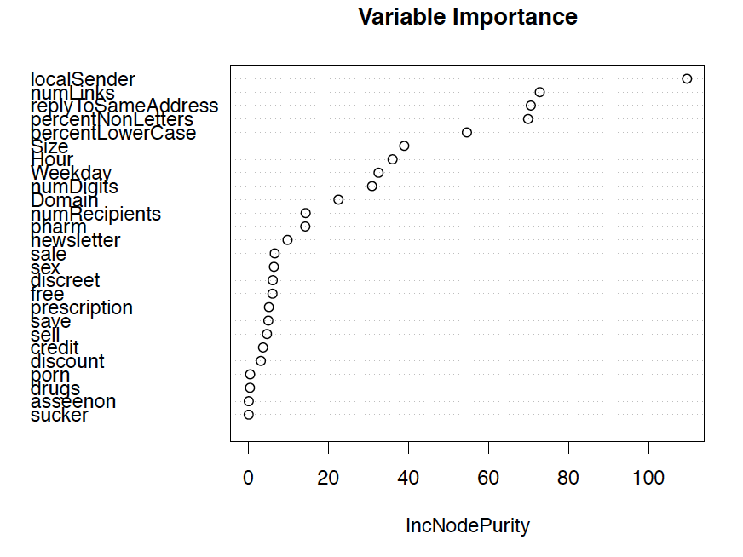
Conclusion

